Slide 1
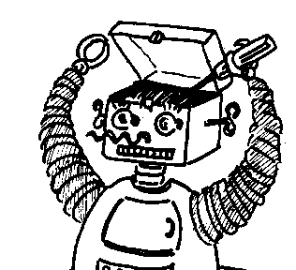
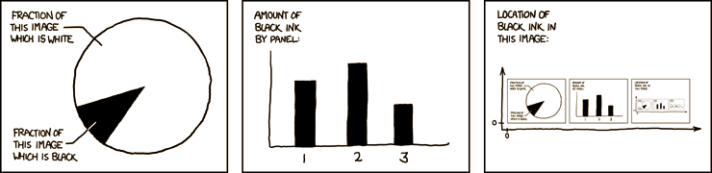

Maryland Metacognition Seminar
http://xkcd.com/
Why human metacognition does not provide a model for machine design: People are not machines; Machines are not people
Ben Shneiderman
Department of Computer Science, University of Maryland, College Park
13 February 2013, 12:00 PM
A. V. Williams Bldg., RM. 3258, College Park
Abstract:
The short-term guidance for designers and long-term outlook for philosophers depends on assumptions about differences between people and machines. This talk will offer fresh examples designed to clarify what language is appropriate for describing machine awareness, responsibility for failures, and intent in complex systems that include automated/autonomous components. Underlying questions are how people are different from machines and how a deeper understanding of these differences can lead to more effective designs in the short and long term?

